Slide 1

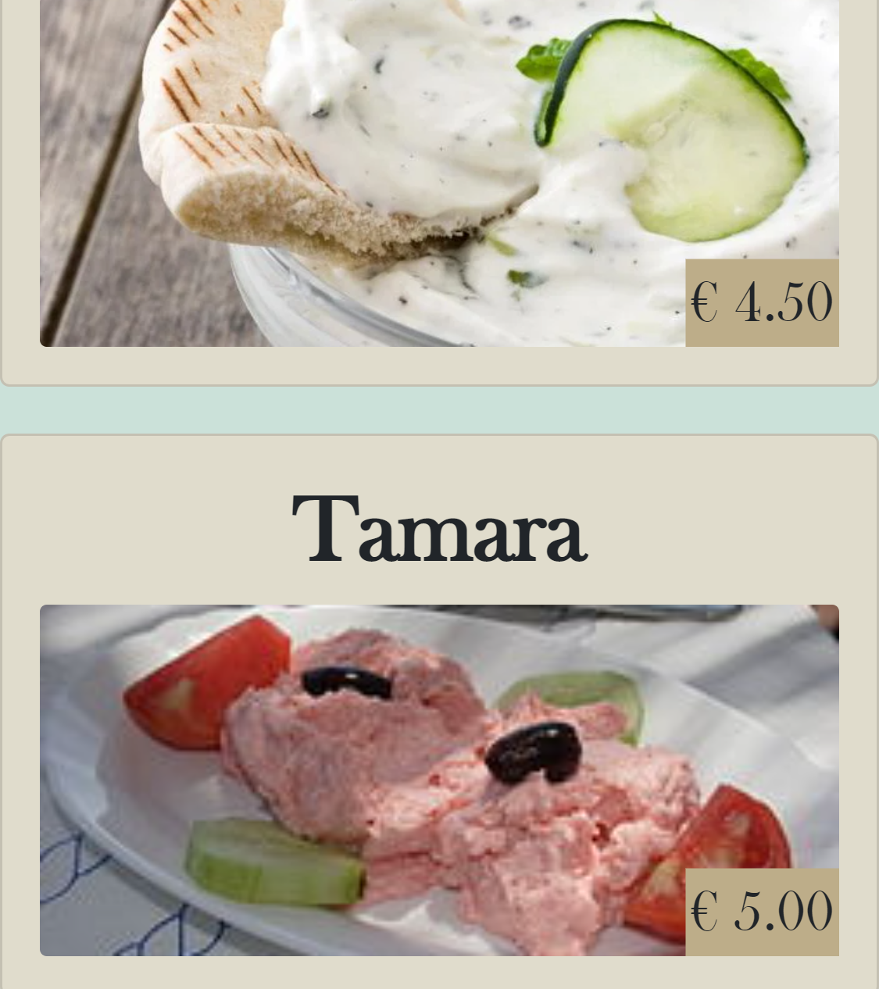

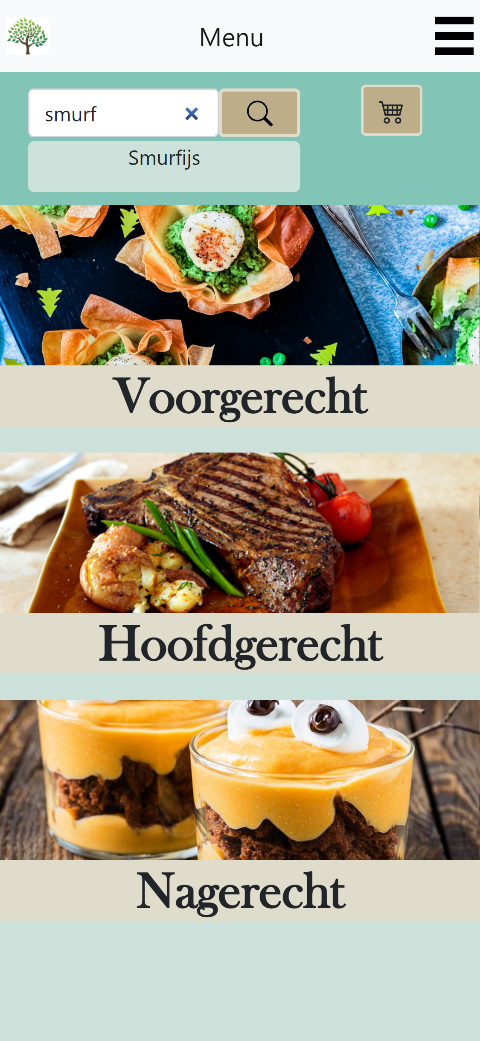
Customer App Sprint 3
Onderdeel van RigS

Slide 2

Inhoud
Sprint planning
Demo
Planning sprint 4

Slide 3

Sprint planning
Guest can place an order for selected products.
Guest can register table number.
Guest can view all his/her ordered products.
Guest can call an employee when he has a problem.
(extra) Guest can search on products.

Slide 4
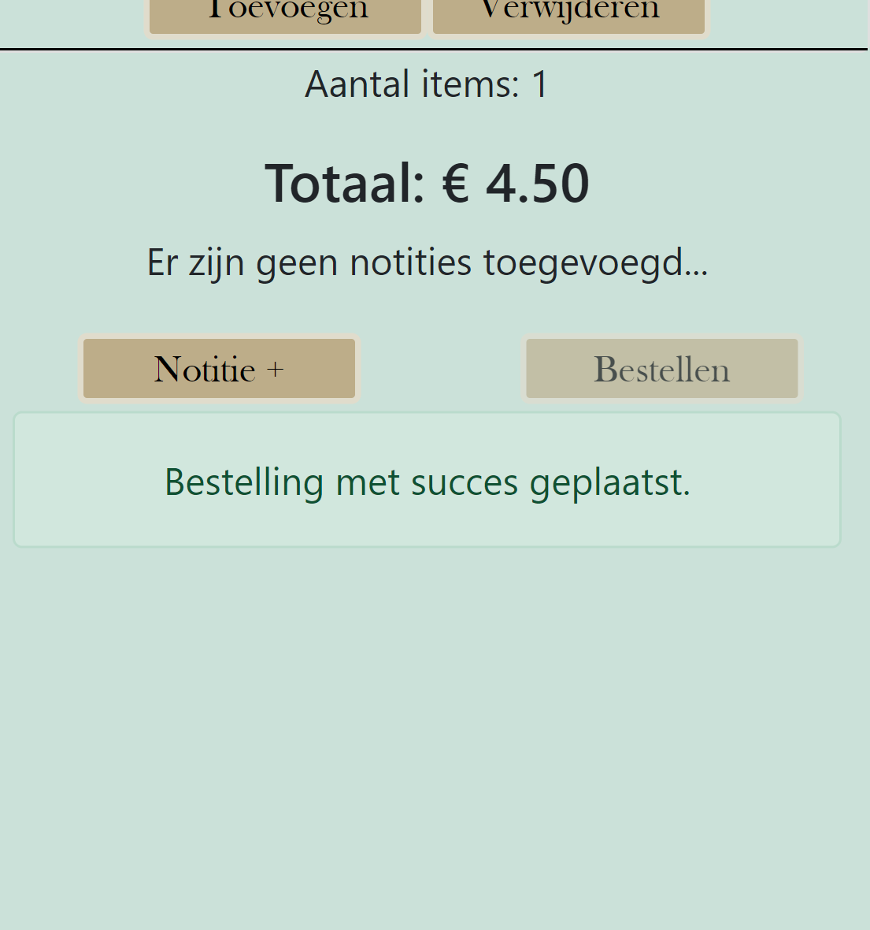
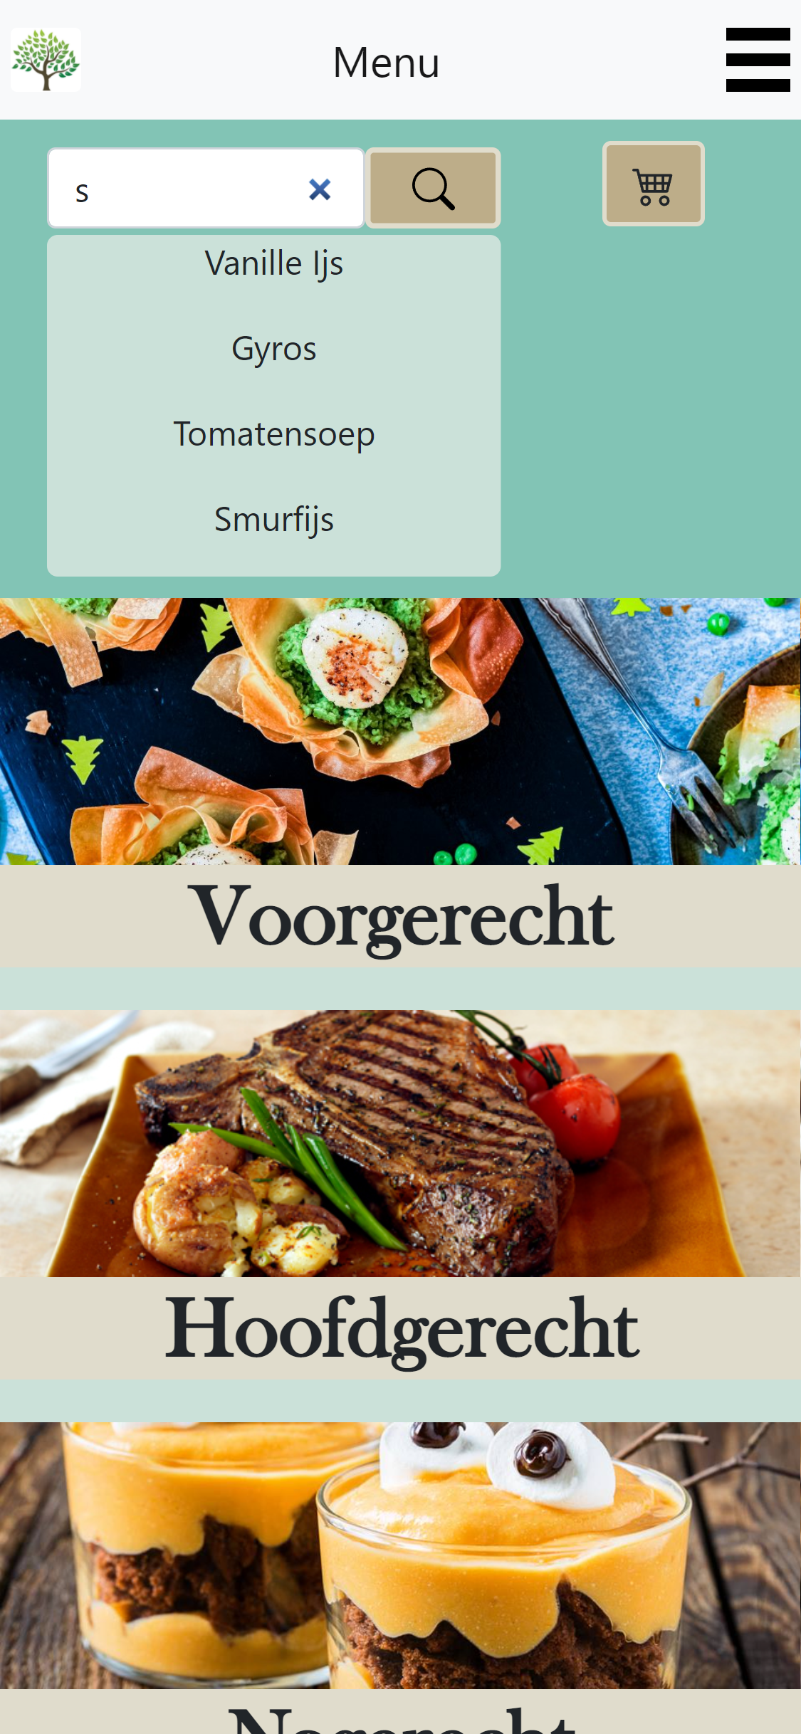
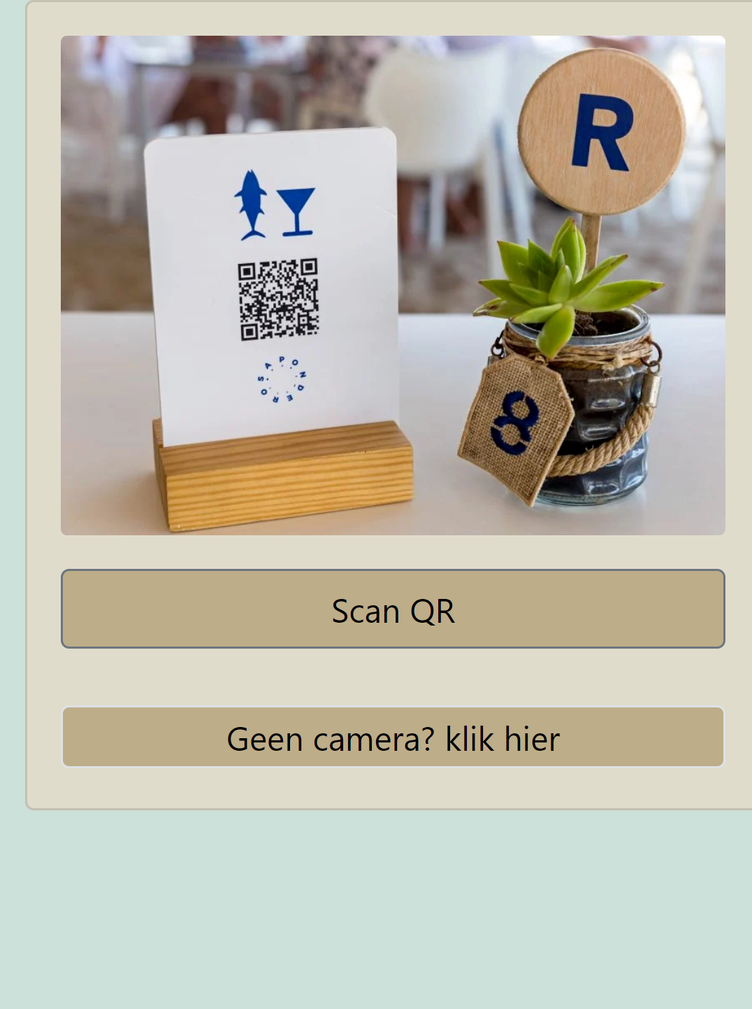

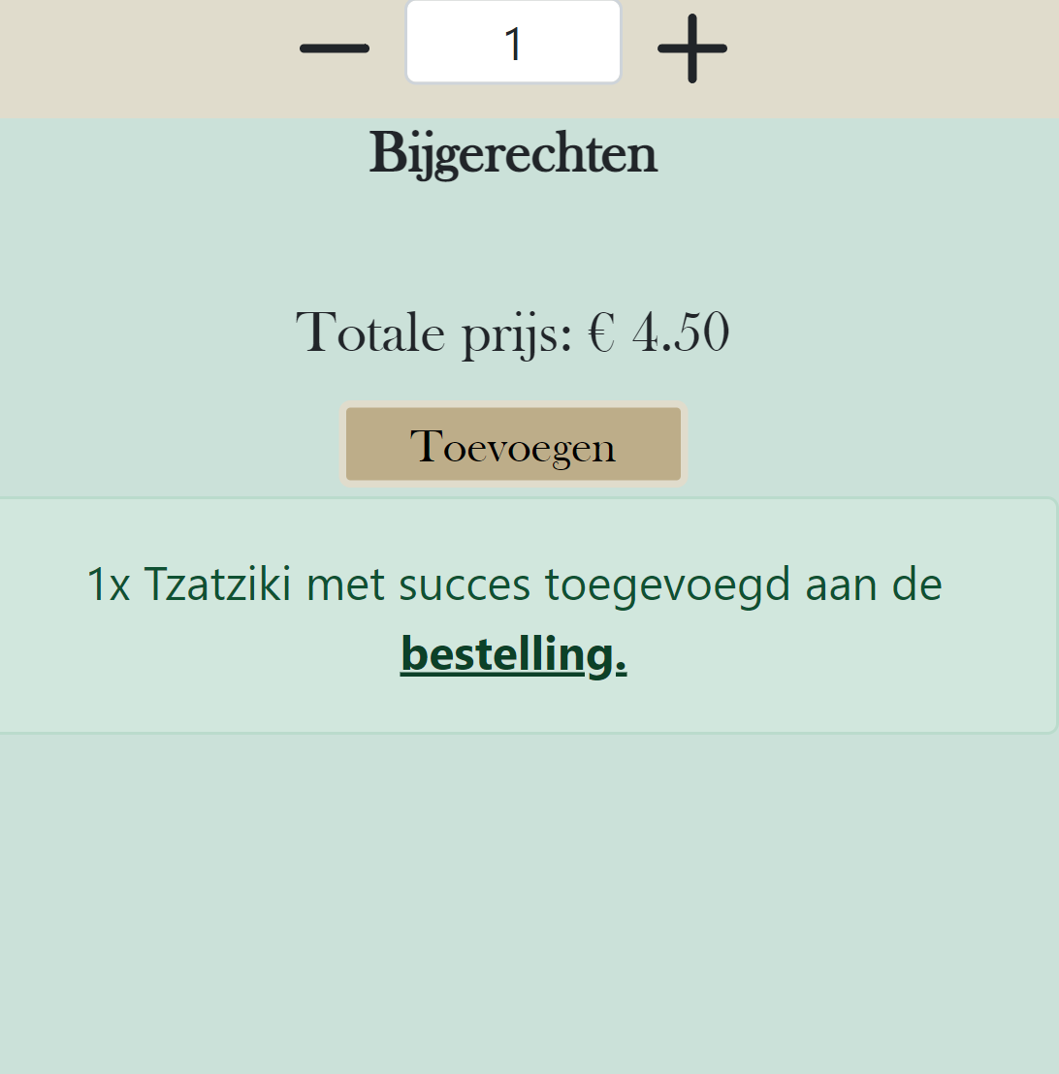
DEMO

Slide 5

Planning sprint 4
4 Guest can filter by the category of food they need.
6 Guest can filter allergies.
10 Guest can add a note to a product, before going to order.
15 Guest can call an employee when he has a problem
18 Guest can view their order status.
19 Guest can download their bill.

